Slide 1

Laptop Market Analysis Using Web Scraping and EDA

Slide 2
About me
Swati Thaware
Education
I completed my M.Tech in Computer Science and Engineering from RTM Nagpur University in 2022.
💡 Why Data Science?
During my teaching career as an Asst. Professor, I taught Data Science subjects. While teaching, I became interested in how data can be used to solve real-world business problems.
Any work experience?
1 yr. Experience as Asst. Professor at (RTM University Nagpur)

Slide 3
Introduction
Laptop Market
Wide variety of laptop brands (HP, Dell ,Apple, etc.) .
Multiple hardware configurations (Processor, RAM, SSD/HDD, Graphics Card).
Different software options (Windows, macOS, Linux).
Broad price ranges, from budget to premium laptops .
Increasing consumer choice due to numerous models and features.
Frequent discounts and offers on e-commerce platforms, Growing demand for laptops in
education, business, gaming, and personal use.

Slide 4
Project Focus
📥Collect real world laptop data.
📈Analyse the market treads.
💰Study pricing the patterns.
📊 Generate the business insights.

Slide 5
Business Problem Statement
⚠️ Business Challenge
Understanding the pricing strategies with discount and offers
Identify market trends
💡Solution
Build a structure dataset
Perform Clean data
Perform EDA
Generate insights

Slide 6
Project Objectives
📥 Data Collection
Data Collection and web srapping done Flipkart Website
🧹 Data cleaning
Cleaning the data using regular expression while data extraction & missing value handled, duplicate val by using Pandas lib
🛠️ Feature Engineering
Created new Analytical features
📊 EDA
Visualize price trends, brand popularity, ratings, RAM, SSD, and processor distribution.
💡 Business Insights
Generate business insights to support customer and business decision-making.

Slide 7
🌐 Website Selection & Data Source
Website Selected
🛒 Flipkart (E-commerce Platform).
One of India's largest online marketplaces.
Offers a wide variety of laptop brands and models.
Provides detailed product specifications.
Displays prices, discounts, ratings, and customer reviews.
Frequently updated product listings.
Data Source
The laptop dataset was collected from Flipkart using Python Web Scraping.
Soure | Flipkart
Data Types | Laptop data listing
Colletion Method | Web Scraping using python
Page scraped | 10
Initial records collected | ( total 1578 rows after cleaning 932, 13)

Slide 8
Web Scraping Methodology
🌐 Flipkart Website
🔄 Methodology
Selected Flipkart as the data source. Targeted laptop product listing pages.
Inspected the webpage using browser Developer Tools.
Identified HTML tags and CSS classes containing laptop details.
🔍 HTML Inspection
🐍 Requests + BeautifulSoup
Sent HTTP requests using the Requests library.
Parsed HTML content using BeautifulSoup.
Extracted: Brand ,Processor, etc.
Removed duplicate records. Handled missing values.
Converted data types. Cleaned price and discount values
📥 Data Extraction
📄 Pandas DataFrame
🧹 Data Cleaning
📊 Exploratory Data Analysis
Created charts and visualizations. Identified market trends and customer preferences. Generated business insights

Slide 9
Technologies & Libraries Used
🐍 Programmimng Language
Python
🌐 Web-Scraping, Requests,
BeautifulSoup ,Regex
🗄️⚙️ Data manipulation
Numpy & Pandas
📊 Visualization
Matplotlib,Seaborn
</>Development Environment
Jupyter Notebook

Slide 10
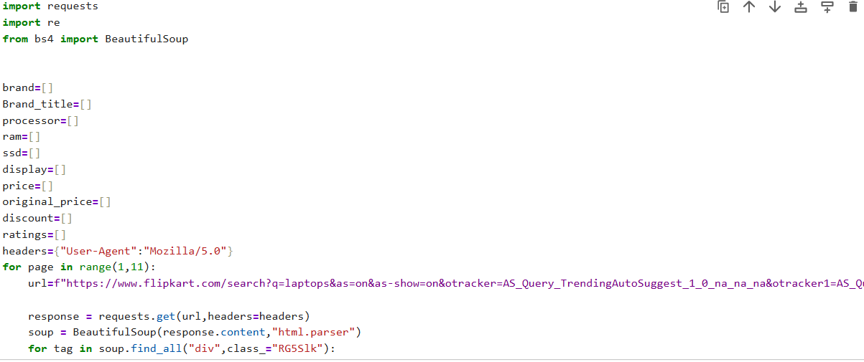
Data Collection Process (Laptop Market Analysis)
Part 1-Web Scraping -Flipkart

Slide 11
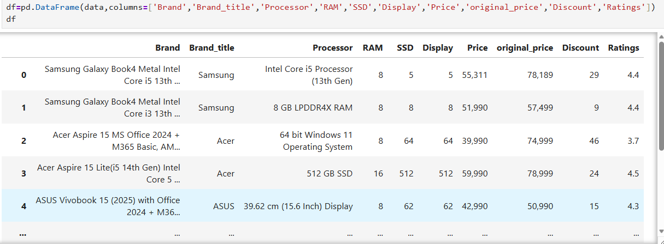
Raw Dataset Overview

Slide 12
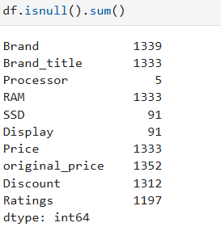
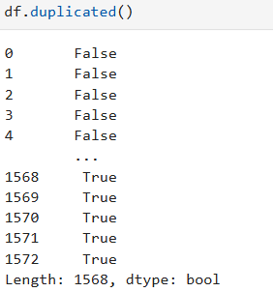
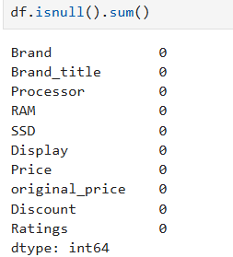
Data Cleaning & Preprocessing
1573
Raw Records
574
Duplicates Remove
909
Clean Records
Before cleaning
After cleaning
Handled Duplicated

Slide 13
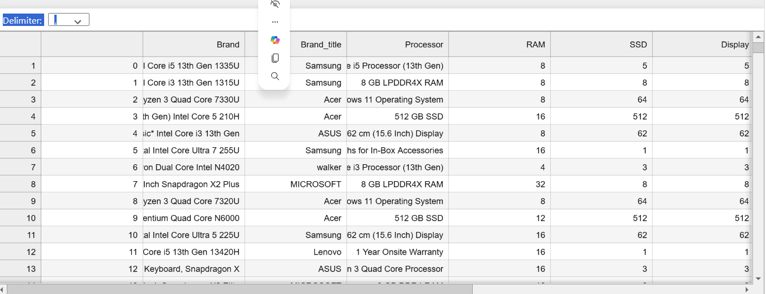
Dataset details
Dataset Details
Data Source: Flipkart Laptop
File Format:CSV
DataType: Structure Tabular Data
Extracted Feature :9
Features Collected
Brand ,Processor, RAM, SSD, Display ,Price Discount, Ratings.
Missing value handling ,Duplicate removal, Data type conversion

Slide 14
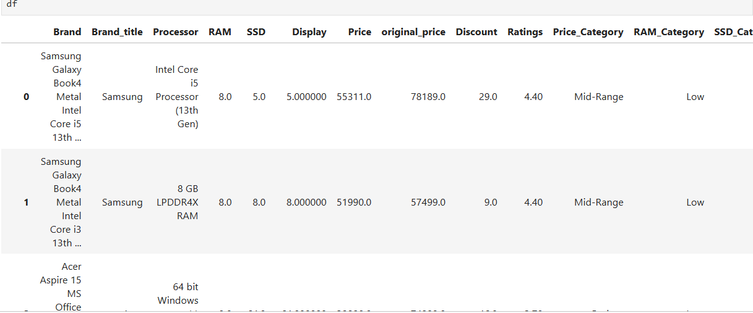
Created new columns like Price_Category,RAM_Category,SSD_category

Slide 15
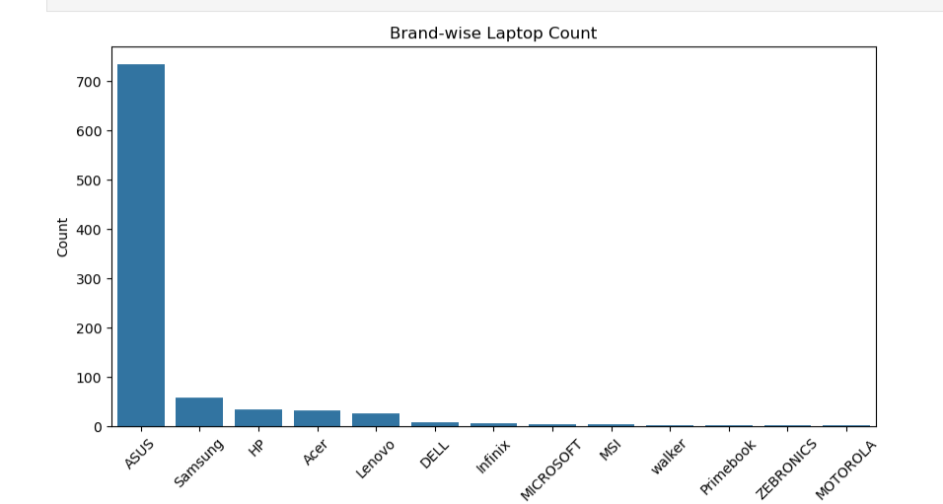
Exploratory Data Analysis (EDA)
Univariate Analysis for Brand Analysis:
Univariate Analysis means analyzing one variable at a time.
In the given countplot Asus brand dominating the market.
The count plot displays the number of laptops available for each brand. Brands with taller bars have more laptop models listed on Flipkart. Brands with shorter bars have fewer laptop models. This visualization helps identify the most and least represented brands in the dataset.

Slide 16
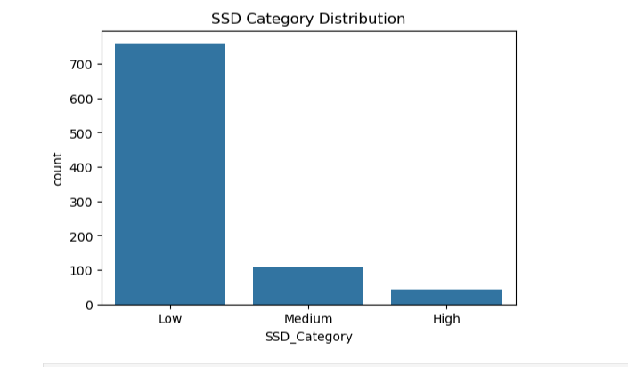
1.Univariate Analysis for SSD_category Analysis:
In the given countplot Low SSD storage (256) gb dominating the market.
Low Storage (≤256 GB): Suitable for basic usage. Medium Storage (257–512 GB): Most common category for everyday users. High Storage (513 GB–1 TB): Preferred by professionals and gamers. Very High Storage (>1 TB): Premium laptops with large storage capacity.

Slide 17
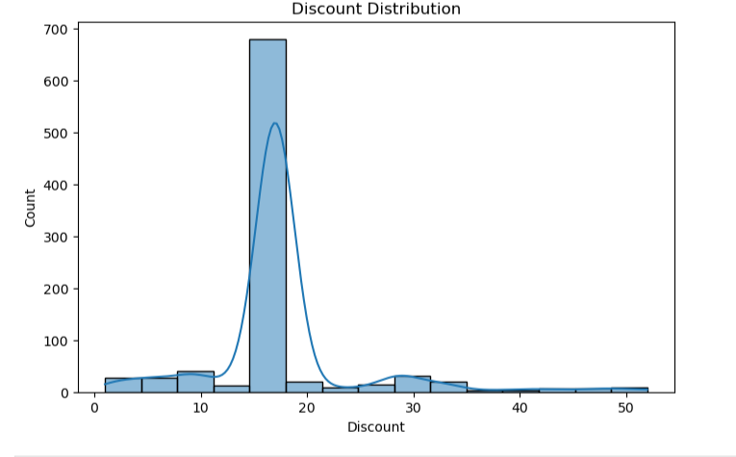
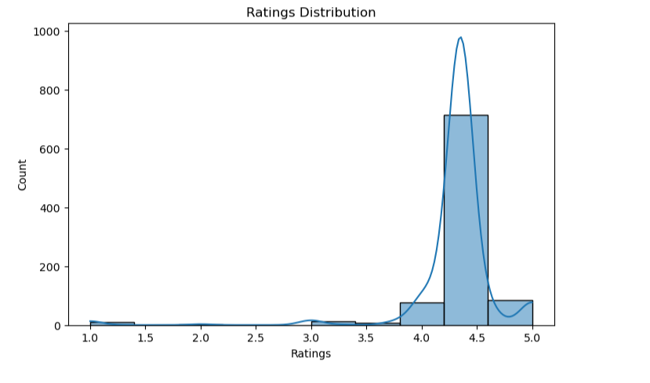
Univariate Analysis for 1.Discount_category Analysis:
In the given countplot greater than 20% to 30% discount having higher sales.
2.Univariate Analysis for Rating Analysis:
In the given countplot 4 to 4.5 is the higher ratings for the laptop.

Slide 18
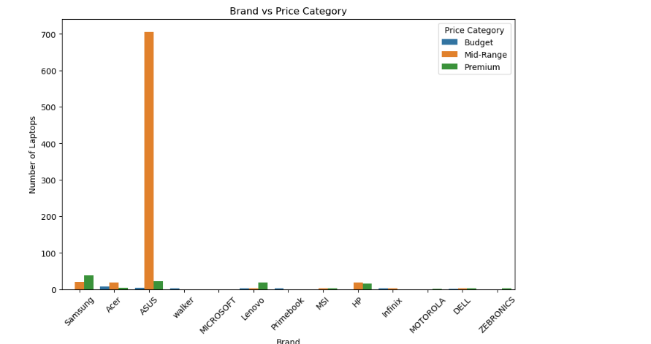
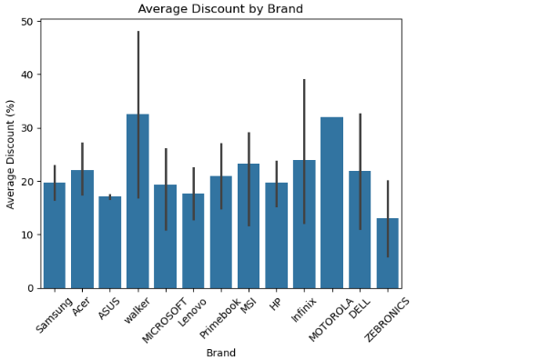
EDA Bivariate Analysis
1. Brand Vs. Price
Asus offers laptops across all three price categories.
Asus,Samsung HP,Acer has a strong presence in the Mid-Range category.
ASUS offers both Mid-Range and Premium laptops.Budget laptops are concentrated among brands such as Acer, Infinix, and Ultimus (depending on your buget).
2.Avg Discount by Brand:
In this barplot its clearly shown that almost all brands like Asus , Lenovo,walker,offers the discount from 20 to 30%.

Slide 19
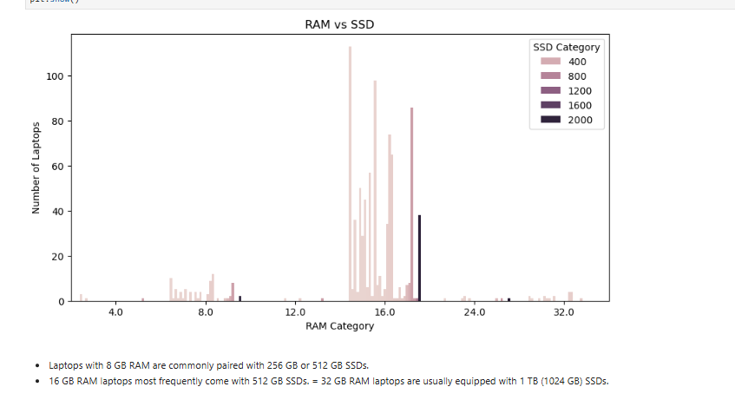
EDA Bivariate Analysis
RAM VS.SSD
Laptops with 8 GB RAM are commonly paired with 256 GB or 512 GB SSDs.- 16 GB RAM laptops most frequently come with 512 GB SSDs.- 32 GB RAM laptops are usually equipped with 1 TB (1024 GB) SSDs.
Premium laptops often combine 16 GB or 32 GB RAM with 512 GB or 1 TB SSD. Budget laptops typically have 8 GB RAM and 256 GB or 512 GB SSD. The scatter plot helps identify whether manufacturers tend to pair higher RAM with higher storage

Slide 20
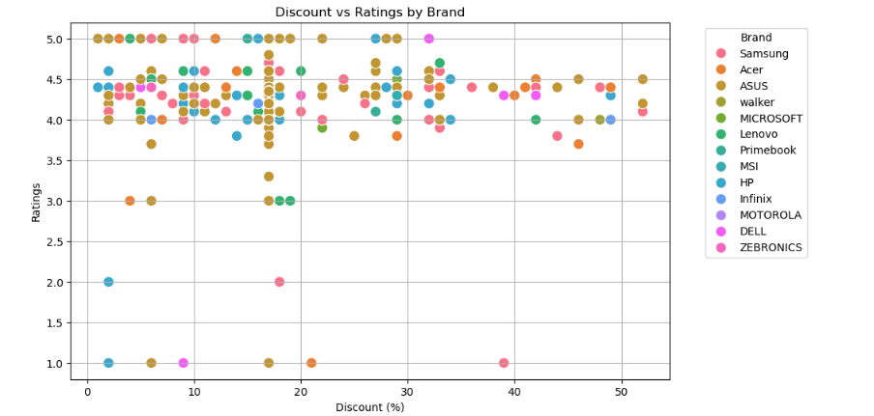
EDA Multivariate Analysis
1.Discount Vs Ratings VS Brand
Each point represents one laptop.
The x-axis shows the Discount (%). The y-axis shows the Customer Rating.Different colors (in the first plot) represent different Brand_Title values, making it easy to compare brands and identify patterns or outliers.

Slide 21
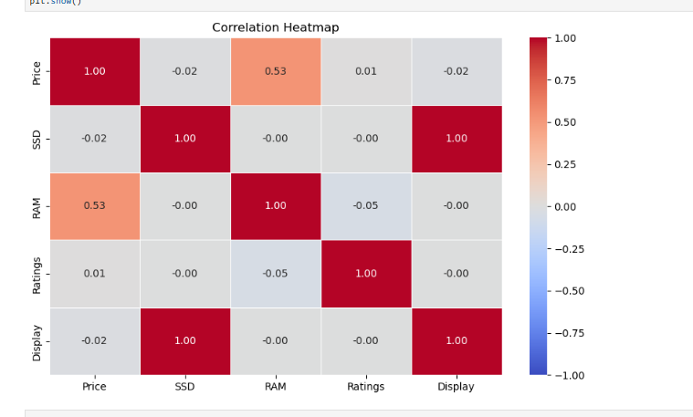
EDA Multivariate Analysis
1. Price Vs SSD Vs RAM Vs Rating and Display
RAM ↔ Price: Strong positive correlation (higher RAM often means higher price). SSD ↔ Price: Positive correlation (larger SSDs tend to increase price). RAM ↔ SSD: Moderate to strong positive correlation. Discount ↔ Price: Often weak or negative correlation. Ratings: Usually weak to moderate correlation.

Slide 22
Key Analysis Questions (Use Cases)
1. Which laptop brand has the highest number of listings on Flipkart?
Brands like HP, Lenovo, and ASUS have the highest number of laptop listings, indicating a strong market presence.
2. Which price category contains the most laptops?
The Mid-Range category has the highest number of laptops, showing that most products target average consumers.
3. Does higher RAM lead to higher laptop prices?
Yes. Laptops with 16 GB or 32 GB RAM generally have higher prices than those with 8 GB RAM.
4. Is there a relationship between SSD capacity and laptop price?
Yes. Laptops with 512 GB and 1 TB SSDs are generally more expensive than laptops with 256 GB SSDs.
5. Which brands provide the highest discounts?
Budget-oriented brands generally offer higher average discounts, while premium brands tend to offer smaller discounts.
6.Which processor category dominates the market?
Mid-Range processors (such as Intel Core i5 and AMD Ryzen 5) appear most frequently, indicating strong customer demand

Slide 23
Conclusion & Key Findings
Conclusion :
This project demonstrates how Python, Web Scraping (Requests & BeautifulSoup), Regular Expressions, Pandas, NumPy, Matplotlib, and Seaborn can be used to collect, clean, analyze, and visualize real-world e-commerce data. The insights generated support better business decisions, competitive analysis, and customer-focused product recommendations.
Key Findings:
  HP, Lenovo, and ASUS have the highest number of laptop listings, indicating strong market presence on Flipkart.
  The Mid-Range price category contains the largest number of laptops, making it the most competitive market segment. Laptops with 16 GB RAM and 512 GB SSD are the most common configurations, showing high customer demand for balanced performance and storage.
  Premium processors (Intel Core i7/i9, Intel Core Ultra, AMD Ryzen 7/9) are generally associated with higher-priced laptops.
  There is a positive relationship between RAM, SSD capacity, and price—higher specifications usually result in higher laptop prices. Most laptop ratings fall between 4.0 and 4.5, indicating generally high customer satisfaction across brands. Discounts vary by brand, with budget-oriented brands typically offering larger discounts than premium brands. Premium brands generally have higher average prices, while budget brands focus on affordability and competitive discounts. Display sizes are relatively consistent across brands, with 15.6-inch displays being the most common.

Slide 24
Visualizations & Insights
Univariate Analysis:
Univariate Analysis means analyzing one variable at a time.
In this Countplot it is clearly visible that asus

Slide 25
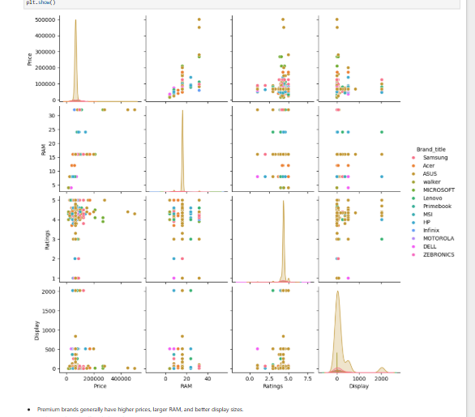
Visualizations & Insights
Premium brands generally have higher prices, larger RAM, and better display sizes.- Mid-range brands offer a balance between price and ratings.
Brands with 16 GB or 32 GB RAM are mostly in the higher price segment.- Display size varies only slightly across brands, while price and RAM show larger differences.
Highly rated laptops are available across multiple brands, indicating that customer satisfaction is not determined by price alone.

Slide 26
Challenges Faced During the Project
  Dynamic Website Structure
  Product information was stored in different HTML tags and classes, making data extraction challenging.
  Missing Values
  Some laptop listings did not contain complete information such as ratings, discounts, SSD capacity, or display size, requiring data cleaning.
  Data Cleaning
  Prices, discounts, RAM, and SSD values contained symbols and text (₹, %, GB, TB) that had to be cleaned and converted into numeric values.
  Duplicate Records
  Similar laptop models appeared multiple times due to different sellers or offers, requiring duplicate detection and removal.

Slide 27
Future Improvements
By integrating machine learning, real-time data updates, multiple data sources, and interactive dashboards, this project can evolve from a descriptive EDA study into a comprehensive laptop market intelligence platform that supports both customers and business decision-makers.

Slide 28

THANK YOU

